Slide 1
Testing Session-4

Slide 2
Agenda
Positive Testing
Negative Testing
Re-Testing
Regression Testing
Non Functional Testing

Slide 3
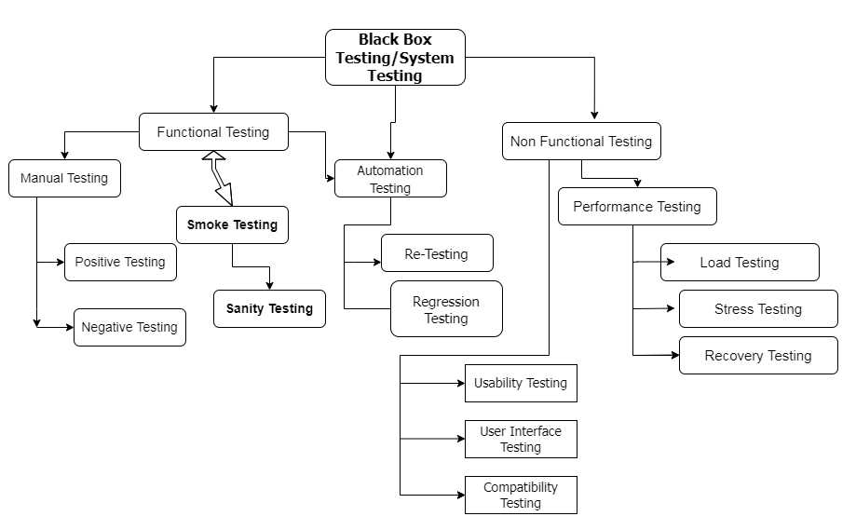

Slide 4
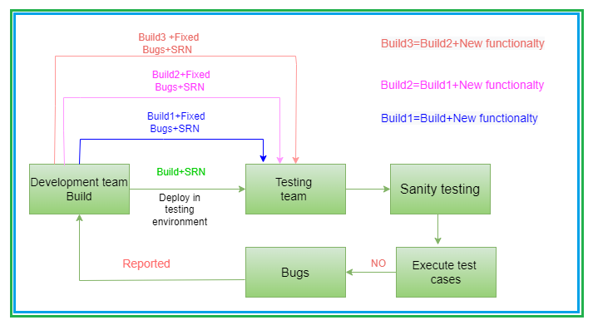
Regression Testing

Slide 5
Regression Testing
Regression Testing is nothing but a full or partial selection of already executed test cases which are re-executed
Code change has not adversely affected existing features.
To ensure existing functionalities working fine.

Slide 6
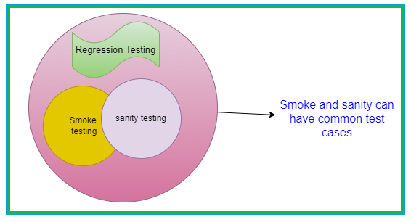

Slide 7
Usability testing
User friendly
User Interface Testing
Basic elements
Spellings
Background colour, font size, alignment
Highlight mandatory fields

Slide 8
Compatibility Testing
Browsers Operating Systems

Slide 9
Why Swhizz?
Following the project-oriented training By working on user stories
Real time people will deliver the classes
Hands on experience.
One to One monitoring
Interaction sessions
Doubts Clarification Session
Expertise in resume preparation
Mock interviews
Job assistance
Associated with 50+ Clients
900+ students got placed

Slide 10

Any Queries?

Slide 11
Thank You
Mr.SubbaRao (Relationship Manager)
Contact:9059002244

